Slide 1


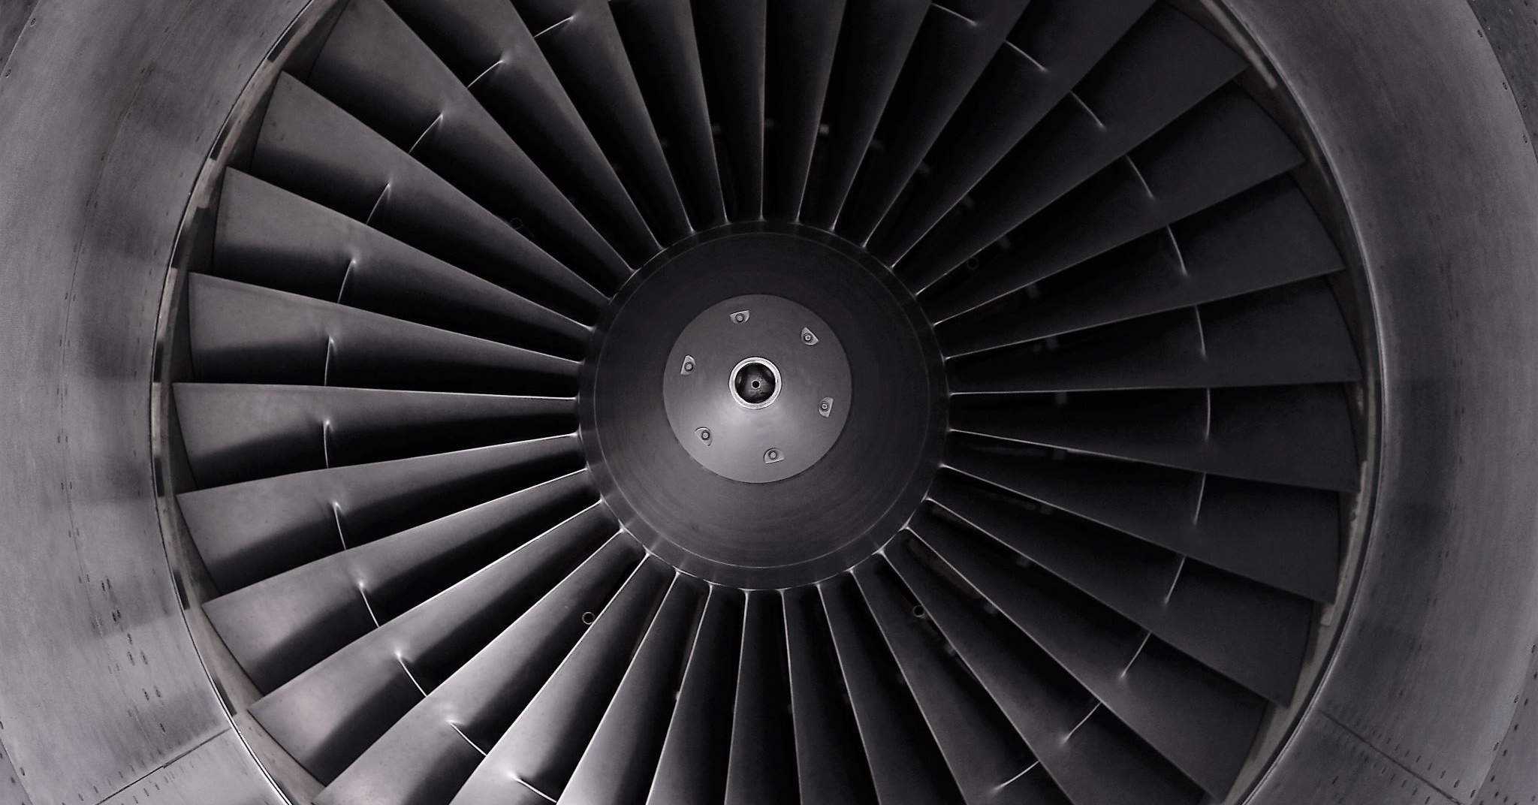

Project title: RUL prediction using LSTM for Aircraft Engine
Group name:
Lohadaarshan a/l Gopal
Ahmed abdi Mohamed
Nerushan a/l Jeyakumar

Slide 2
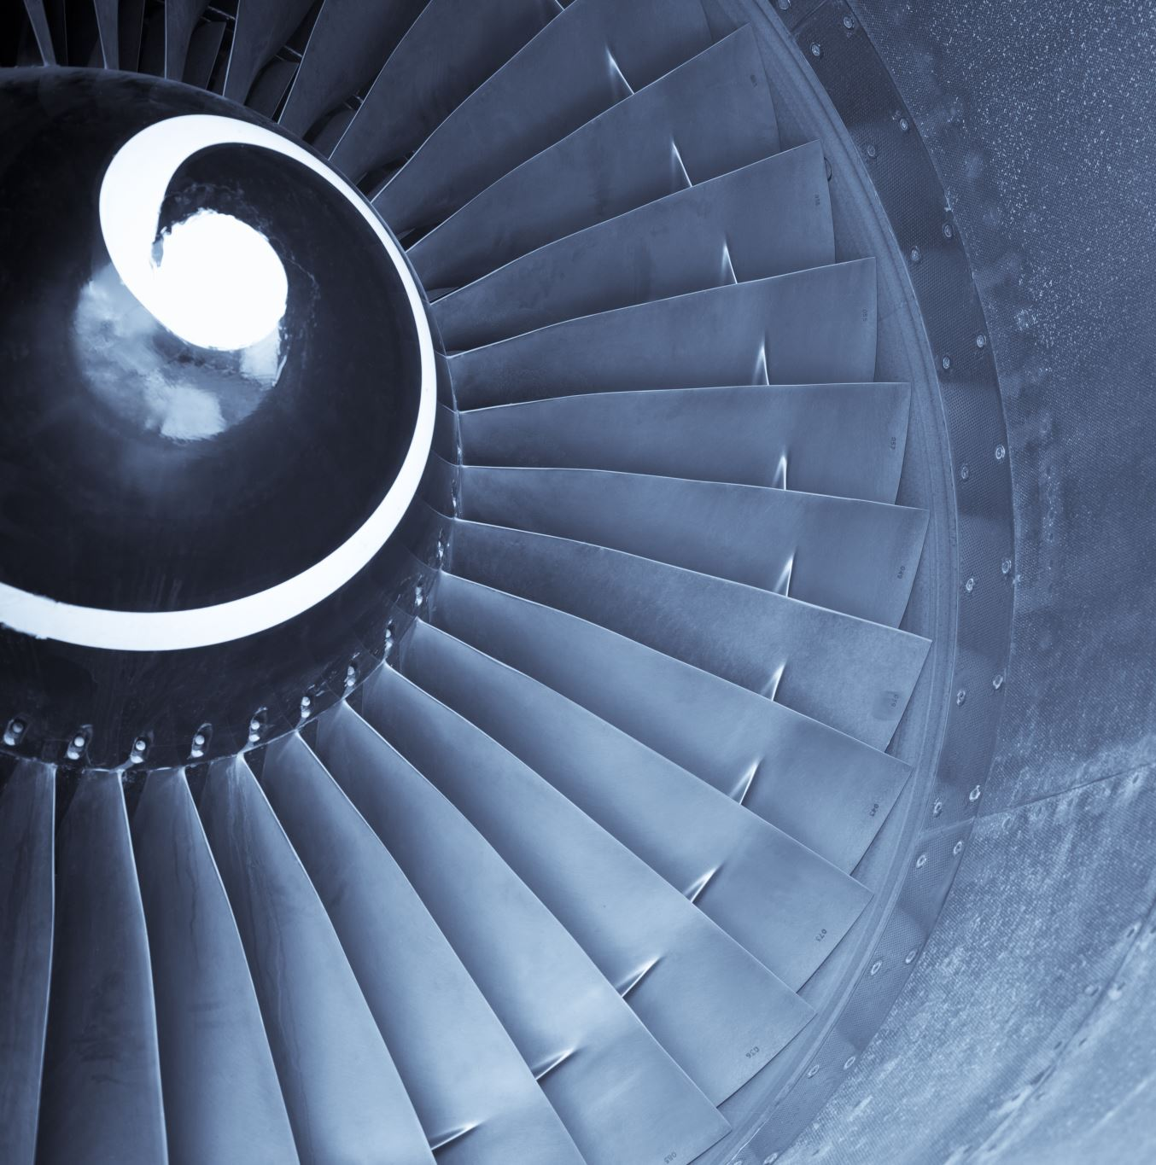
Introduction
Objective: Implement LSTM neural networks to predict the Remaining Useful Life of aircraft engines, enhancing maintenance efficiency and safety.
Significance: Aims to revolutionize predictive maintenance, ensuring timely interventions and reducing unexpected downtimes in aviation.
Approach: Utilizes advanced data analysis and machine learning techniques to accurately forecast engine maintenance needs.
Impact: This project sets to establish a new standard in aerospace maintenance, prioritizing reliability and operational efficiency.

Slide 3

Problem Statement
Current Challenge: Inefficiency and unreliability in existing aircraft engine maintenance schedules due to unpredictable failures.
Limitation of Existing Methods: Lack of precision in forecasting engine RUL with traditional maintenance approaches.
Need for Improvement: A more accurate, data-driven method for predicting engine maintenance requirements.
Proposed Solution: Development of an LSTM-based machine learning model for precise RUL prediction.

Slide 4

Proposed solution
Develop an advanced machine learning model using Long Short-Term Memory (LSTM) networks
Utilize extensive aircraft engine data to train and validate the LSTM model
Create an algorithm capable of accurately predicting the Remaining Useful Life (RUL) of aircraft engines
Integrate this model into existing maintenance systems for real-time predictive analysis
Aim to significantly enhance maintenance scheduling, reduce unplanned downtimes, and improve overall aviation safety

Slide 5
Objectives
Develop and Train LSTM Model: To design and implement a Long Short-Term Memory neural network model that can learn from historical aircraft engine data and accurately predict their Remaining Useful Life (RUL).
Validate Model Accuracy: To thoroughly test and validate the LSTM model using established datasets, such as the NASA C-MAPSS dataset, ensuring high reliability and precision in RUL predictions
Integration with Maintenance Systems: To integrate the LSTM model into existing aircraft maintenance systems, enabling real-time predictive maintenance and optimizing engine service schedules for enhanced safety and efficiency.

Slide 6
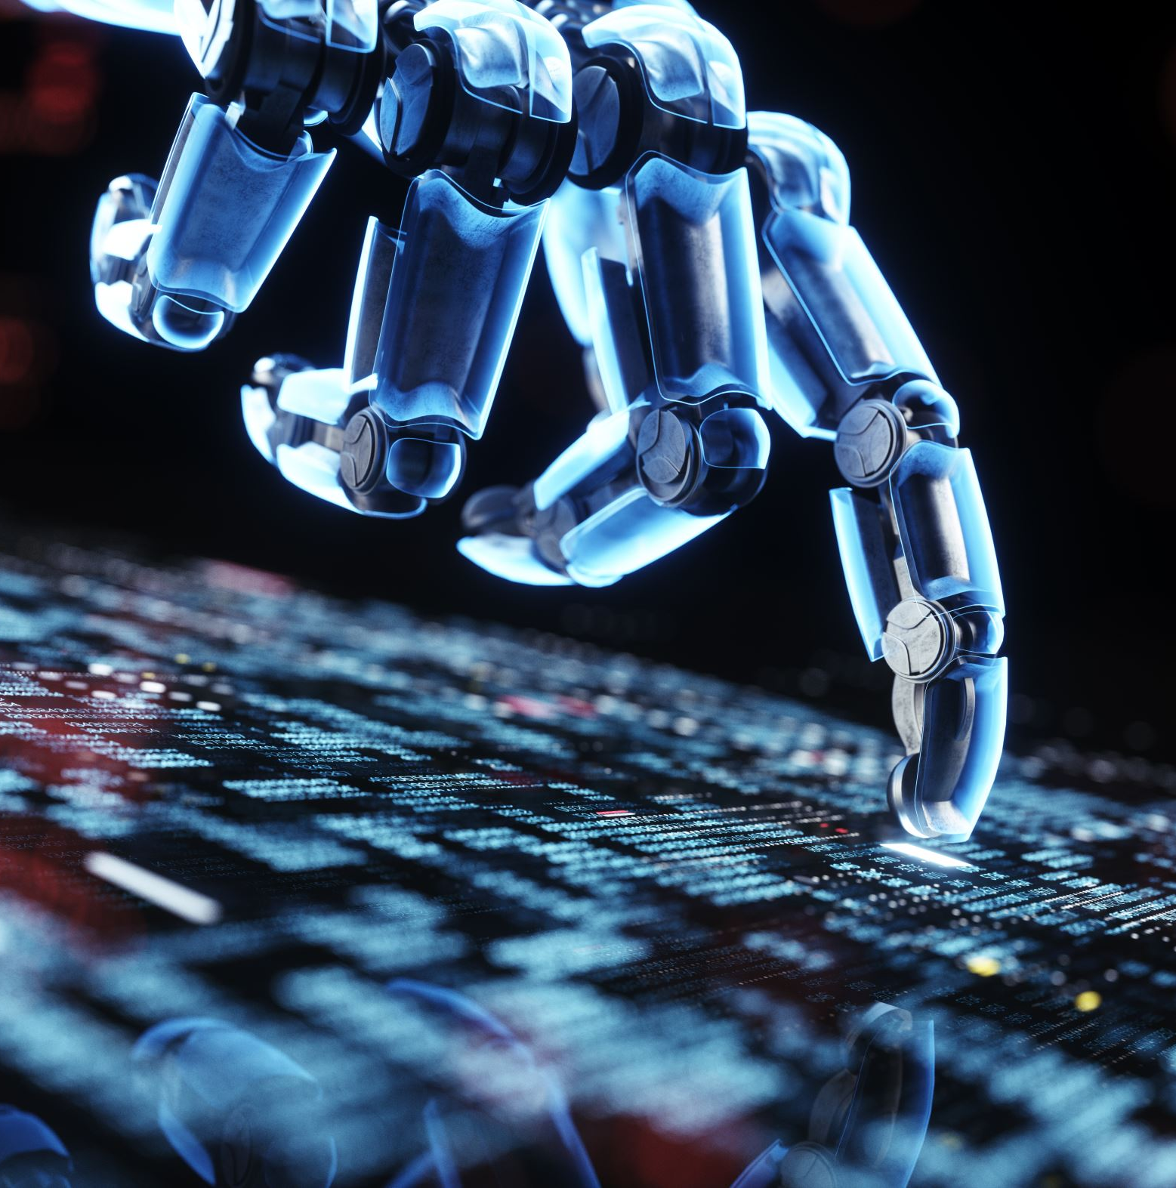
AI and software tools
Python (pandas, numpy)
Machine learning frameworks (tensorflow, pytorch)
Matplotlib(for data visualization)
Github (for code management)

Slide 7
Budget and costing for project management
Category | Description | Estimated Cost
Software Licenses | Cost for AI and data analysis tools | $2,000
Hardware Resources | Computers and servers for model training | $5,000
Data Acquisition | Access to datasets like NASA C-MAPSS | $1,000
Personnel | Salaries for project team members | $20,000
Training & Development | Training courses for team members | $3,000
Miscellaneous | Contingency funds for unforeseen costs | $2,000
Total |  | $33,000

Slide 8
Budget and costing for project testing
Category | Description | Estimated Cost
Test Data Acquisition | Costs for additional or specific test datasets | $500
Testing Tools | Software for testing and validation | $1,000
Personnel | Analysts and engineers for conducting tests | $4,000
Hardware Utilization | Server time for running tests | $2,000
Contingency & Miscellaneous | Unexpected expenses during testing | $1,000
Total for Testing Phase |  | $8,500

Slide 9
Executing process
Data Collection and Preparation:
Gather engine performance and maintenance data, possibly from the NASA C-MAPSS dataset.
Clean and preprocess the data, including normalization and handling missing values.
Segment data into training, validation, and test sets.
Training LSTM Model:
Set up the LSTM neural network architecture suitable for time-series data.
Train the model on the prepared dataset, adjusting hyperparameters for optimal performance.
Validate the model using the validation dataset to ensure it generalizes well.

Slide 10
Executing process
3.Testing and Validation:
Run the trained LSTM model on the test dataset to evaluate its performance in predicting RUL.
Use metrics like Mean Squared Error (MSE) or Mean Absolute Error (MAE) for validation.
Ensure the model's ability to generalize to new, unseen data.
4.Iteration and Improvement:
Analyze the model's performance and identify any underperforming aspects.
Iterate the model training with different parameters or data preprocessing techniques to enhance accuracy.

Slide 11
Expected outcome
Metrics | Expected Outcome
Accuracy | High accuracy indicating model's ability to correctly predict RUL
Precision | High precision showing model's reliability in positive predictions
Recall | Reliable recall indicating model's ability to find all relevant cases
F1-Score | Strong F1-score representing balance between precision and recall

Slide 12
Monitoring and controlling process
Data Quality Monitoring and User Feedback Analysis Process:
Data Quality Monitoring:
Data Collection:
Collect historical operational data from aircraft engines, including sensor measurements, maintenance records, and failure data, ensuring data integrity and accuracy.
Data Preprocessing:
Apply data cleaning, normalization, and feature engineering techniques to prepare the data for LSTM model training.
Data Validation:
Implement automated data validation checks to identify anomalies or inconsistencies in the input data.
Data Quality Metrics:
Define data quality metrics specific to the project, such as data completeness, accuracy, and consistency.

Slide 13

Conclusion
In the pursuit of improving aircraft engine reliability and safety, the project "RUL Prediction using LSTM for Aircraft Engine" has played a significant role. This project has focused on harnessing advanced machine learning techniques, specifically Long Short-Term Memory (LSTM) neural networks, to predict the Remaining Useful Life (RUL) of aircraft engines. The goal has been to provide aviation industry stakeholders with valuable insights that can inform proactive maintenance strategies and optimize the operational life of these critical components.

